Slide 1
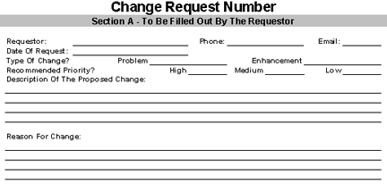
12
dunkinjoe@jpl.nasa.gov
Joe Bagofdonuts
x3941
1-27
x
x
Add the Sun!
Where is the sun? Without the Sun, what is making the planets go ‘round? Dark matter? A black hole? Geez, even a computer programmer should understand the basic laws of physics!

Slide 2
25
cutthecheese@jpl.nasa.gov
Vinny Velveeta
x3837
1-15
x
x
Fix the day function buttons: (1) Add Day, (2) Minus Day, and (3) Reset Day.
Waddya think we are? Mindreaders? The only way to change the mission day is using the (apparently secret) keyboard controls. How about bringing this code into the new century and giving us some working GUI controls!

Slide 3
108
glassceiling@jpl.nasa.gov
Wally Wonka
x3997
1-28
x
x
Draw orbits of Earth and Mars
In his theory of general relativity, Einstein states that objects (e.g., the Sun) warp space-time. Furthermore, space-time governs the motion of objects (e.g., the Earth). The orbit outlines requested above are the embodiment of these tenets. Therefore, this request can be considered as coming from Einstein himself.

Slide 4
107
dofriesgowiththatshake@jpl.nasa.gov
Johnny Rocket
x3835
1-25
x
x
Calculate and display the current linear (dD) and angular (dAng) separations between Earth and Mars.
Predict the “Age of Aquarius”. To quote those seers of the cosmos, The 5th Dimension, “When the moon is in the Seventh House. And Jupiter aligns with Mars. Then peace will guide the planets. And love will steer the stars. This is the dawning of the Age of Aquarius”
.

